Slide 1
Understanding & Predicting Federal Budget Cuts
Section 1 Group 10: Xiyuan (Sophia) Shen, Alyssa Albritton, Azreen Anwar, Duaa Alzouby, Timothy Baldwin

Slide 2
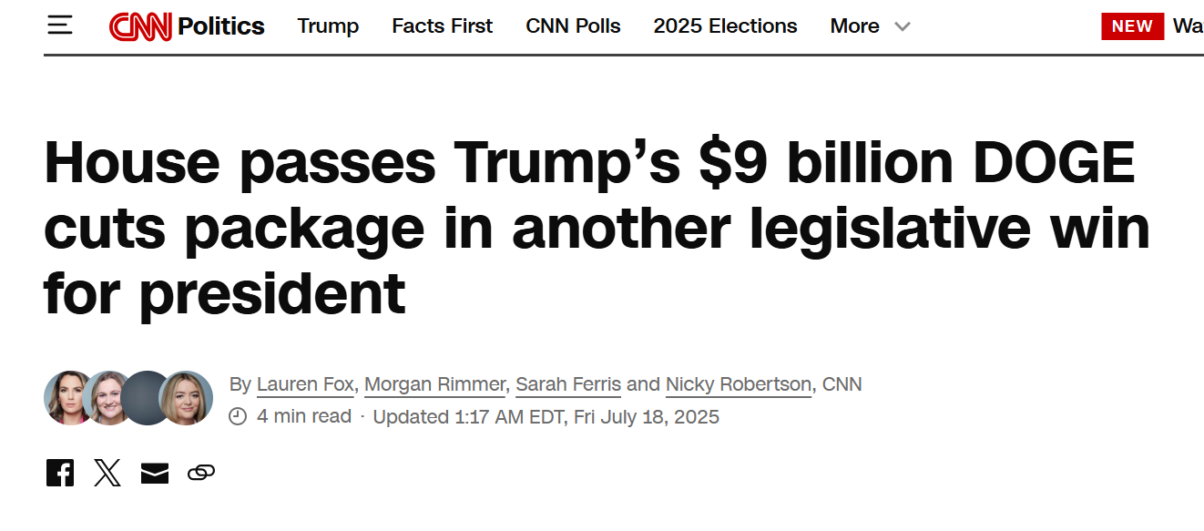
Intro
In February of this year, the Department of Government Efficiency (DOGE) began mass cuts to federal contracts, grants, and the workforce.
Notes:
Every year, millions in federal grant funding vanishes. But this year, driven by major governmental shifts and the rise of programs like DOGE, those cuts are hitting a crisis point. These aren't just budget numbers, they are funds that directly fuel our research, shape our education, and build our campus infrastructure here at UNC. Today, we'll use federal data to show you how funds are being cut and what that means for people across North Carolina and within UNC.

Slide 3
Which grant characteristics are associated with federal budget cuts in North Carolina, and how well can these cuts be predicted?
Notes:
This leads us to our research question for this project

Slide 4
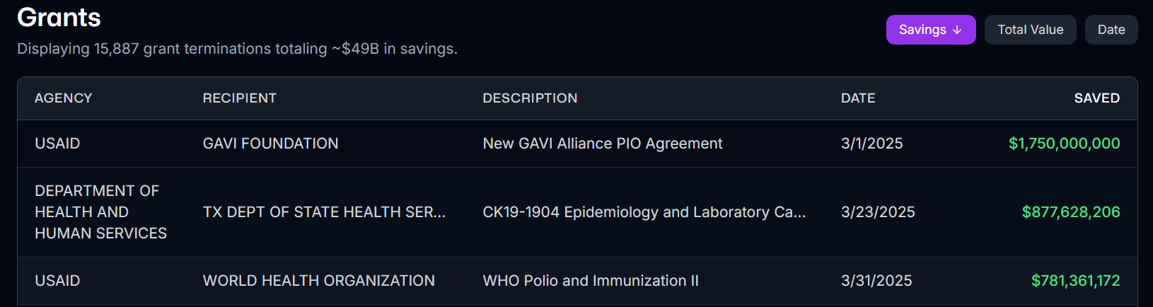
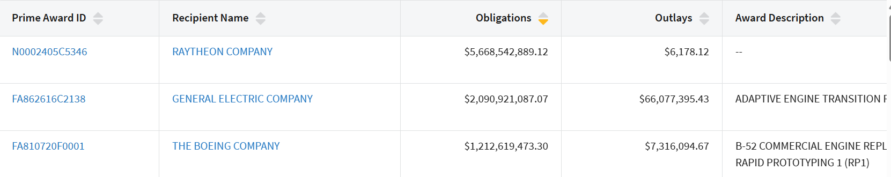
Datasets Explained
3 Datasets
usaspending.gov: Data provided by federal agencies & grant recipients from 2020-25
DOGE: Data provided by the Department of Government Efficiency website in 2025
North Carolina County Population: Data provided by the NC Office of State Budget and Management from 2024
From DOGE’s website:
From USASpending website:
Notes:
USASpending Website: contains information about grants from federal agencies. We focused on North Carolina between 2020-2025
DOGE Website: contains information on how much funding DOGE was responsible for cutting (cancellation of the contract)
“savings” amount is really doge’s cut
OSBM site: information on the county population (for an analysis of per capita funding decline for different counties)
USASpending: general information about spending

Slide 5
Analysis of Merged Dataset
Merged Dataset
Target Variable: savings
Merged on: fain_key
Shape: 234 x 27
Important Features:
award_amount
total_obligated_amount
recipient_name
primary_place_of_performance
The difference between the total expenditure and amount currently obligated
Notes:
Put datasets.head() sample images.
Explain fain_key and what it means in the context of the dataset
Federal Award Identification Number (FAIN) is the unique ID within the Federal agency for each (non-aggregate) financial assistance award. This unique ID allows for us to easily merge the DOGE ‘savings’ information with the grant information from USASpending.
Savings - target variable
As defined by the Department of Government Efficiency, the difference between total value of government expenditure (in the form of grants) and the amount currently obligated
In other words, the amounts cut by DOGE. This is calculated by the federal agency itself.
**The reason it is important to be looking at the savings column from DOGE is because spending budgets are less for reasons other than DOGE’ cancelling the contract

Slide 6
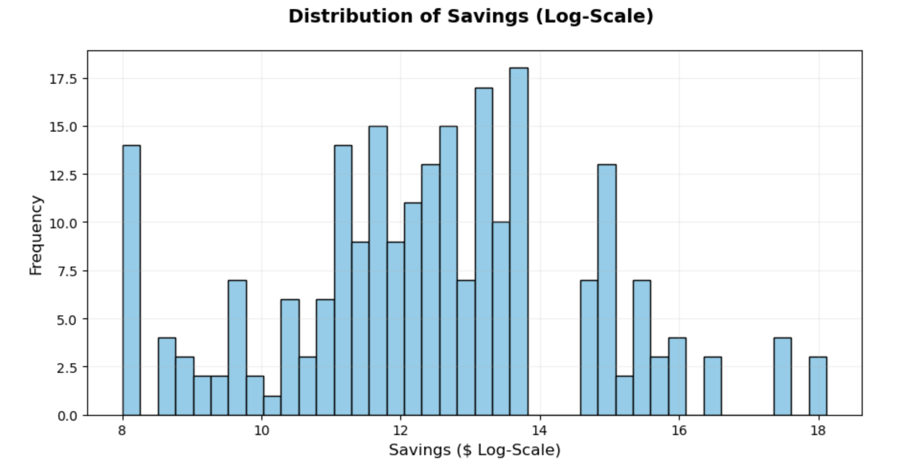
Distributing of Target
Approximately continuous normal distribution
Range: $3,000 - $66M
Center: $450K - $700K
Notes:
Distribution of savings graph:
Why log scale: original savings data is right skewed, many small values and a few massive values. A log scale compresses it
Findings: Cuts range from $3000 to $66,000,000. The distribution is a smooth continuous somewhat normal distribution, with a center between $450,000 to $1,200,000.

Slide 7
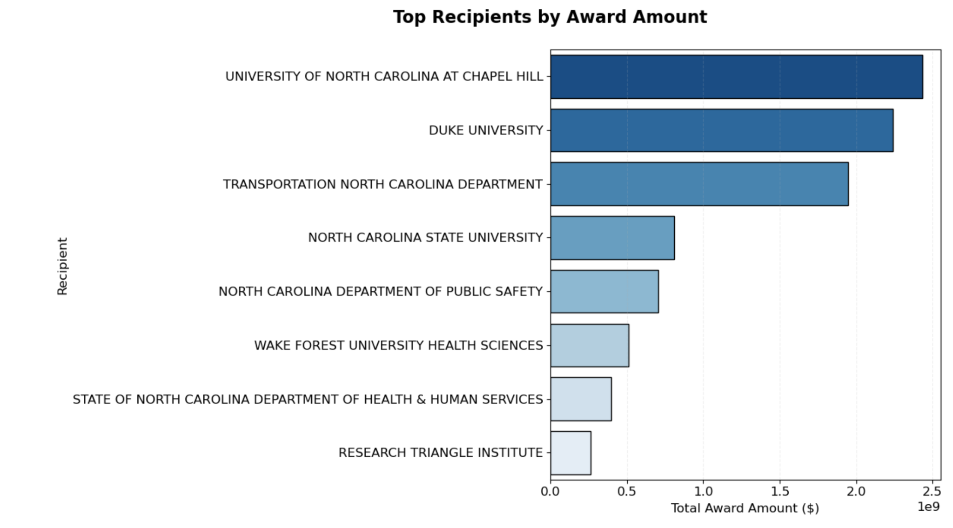
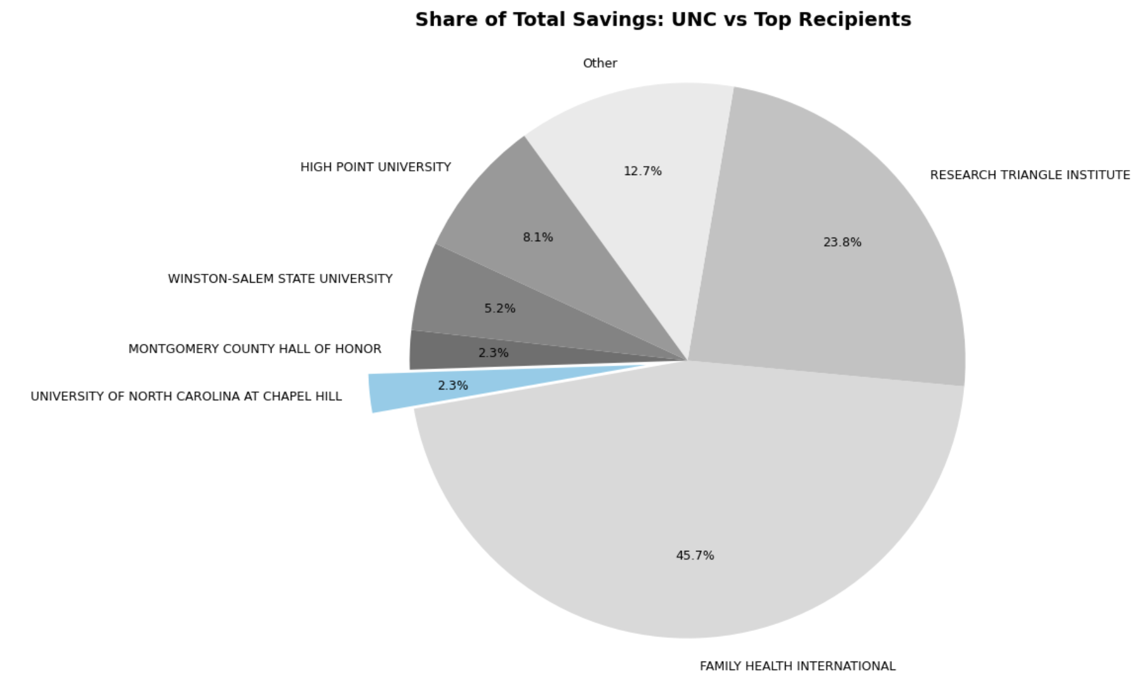
Who is most impacted?
Although UNC is the largest grant recipient, it’s less affected by DOGE programs and only has 2.3% cut.
Notes:
UNC is largest recipient, with around 2.5B in the past 5 years

Slide 8
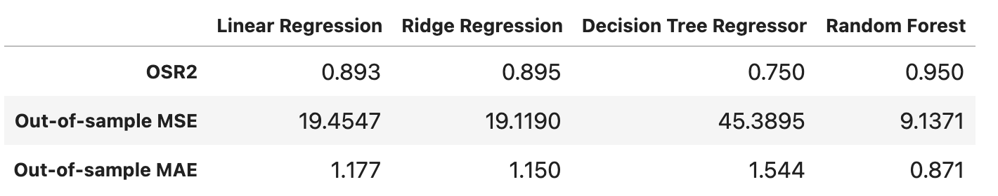
Model Construction
Predictors chosen through correlation: sector (branch), value (estimated total value from DOGE), total_obligated_amount (sum of federal government’s committed amount for a specific purpose)
Notes:
To build our model, our chosen predictors were sector, value, and obligated amount, which helped us build our four models of linear regression, ridge regression, a decision tree, and decision tree with a 30 % test size and we made each branch its own indicator
With that, the random forest performed the best, with the highest OSR22 and the lowest error. This tell us how accurate the predictions are and how how sensitive they are to large errors
Parameters for these models:
Linear: no parameters
Ridge: alpha = 1.0, controls L2 regularization -> less overfitting
Decision Tree: minimum 5 leafs (at least 5 samples in end nodes) [prevents tiny trees], cost complexity pruning alpha = 0.001 [applies pruning after tree is grown]
Random Forest: 500 trees
Response: Savings (# budget cuts, from DOGE)
Predictor: sector (branch), value (estimated total value from DOGE), total_obligated_amount (funds directed for a specific purpose) *** double check to see if we should have chosen award_amount instead of total_obligated_amount*****
Discuss Model performance and results
Linear regression serves as our baseline and helps interpret the direct effect of each grant characteristic on savings
Decision trees capture nonlinear patterns in savings that linear regression cannot model
Random forests model complex interactions between grant characteristics and produce the most robust predictions (It avoid overfitting)
Ridge to address multicollinearity among financial variables and improve coefficient stability
Why we chose these metrics:
OS R2: best overall quality metric. Tells us how much variance the model explains relative to the mean
OS MSE (mean squared error): MSE penalizes larger errors more heavily than smaller ones
OS MAE (mean absolute error): MAE more robust to outliers

Slide 9
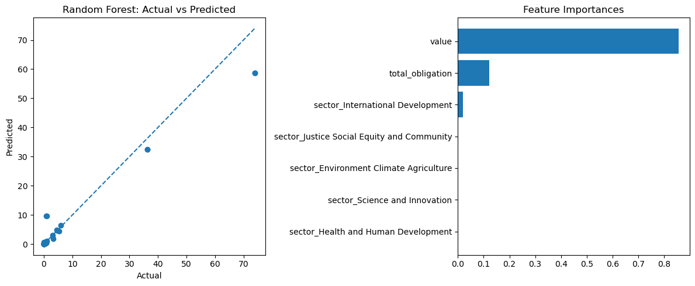
Random Forest Residuals and Feature Importances
Importance
Notes:
Since the Random Forest was our strongest model, we examined its behavior more.
On the left, the actual vs predicted plot shows tight clustering along the diagonal, meaning the model predicts most values accurately.
On the right, we have feature importances which reveals that DOGE’s estimated total grant value is the main predictor, higher than total obligation. We also see that the International Development sector is important and Agencies like USAID, which fund global economic and humanitarian programs, appear to face disproportionately high cuts
With the best OSR2 and residuals, we can conclude that random forest is the best model type for our analysis.
Visual on left: shows residuals for the model
Right: Feature importance. Value/Total obligation are not too shocking, but it seems a sector in International Development has sway on predicting data (making it an influential predictor). “Relative Importance (MDI Score)” (MDI = Mean Decrease in Impurity) For the Random Forest, value contributes the most to reducing prediction error across trees.

Slide 10
Conclusion
Key findings:
Random Forest is the best-performing model with 0.95 R^2
Value is the dominant predictor of savings
High funding does not guarantee large cuts
International Development shows notable impact
Notes:
Value —> meaning the potential highest amount of money government is awarding for the contract
Savings —> what has been cut
Answer the research question to the best of your ability
Discuss DOGE calculation of savings: Controversial methodology in which some experts claim that DOGE conflates its true savings because it subtracts from the “ceiling” or maximum amount that the government COULD be using for the contract rather than what they would’ve actually used
***What does this research mean?
Federal budget cuts are not random: our analysis shows they follow measurable patterns tied to grant value and obligation levels, meaning agencies and institutions can anticipate and prepare for cuts using data-driven models.

Slide 11
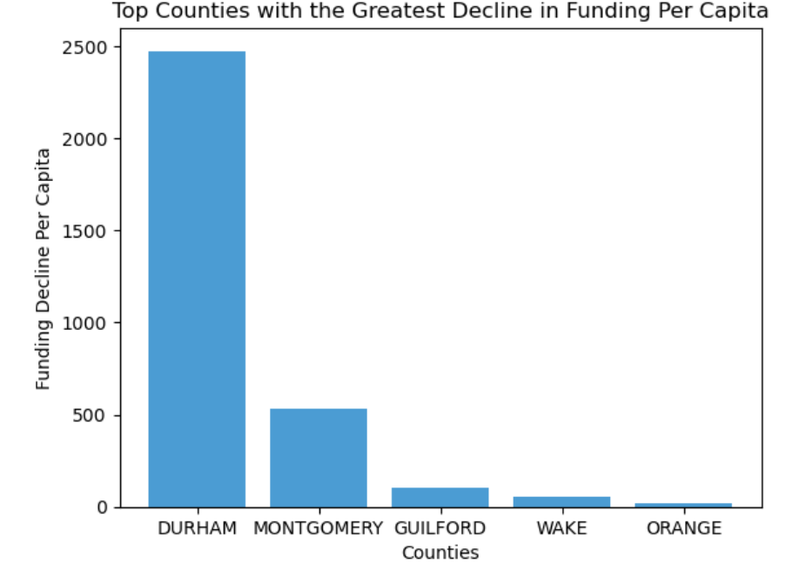
Which Counties are Most Impacted?
Notes:
Another variable we constructed is the “savings” per capita for each county within North Carolina
This is where the third dataset comes in, since we’re dividing the decline by the population
From this graph, you can see the top five counties with the greatest decline per capita in funding from DOGE
Notice how most of these counties contain a large research university?

Slide 12
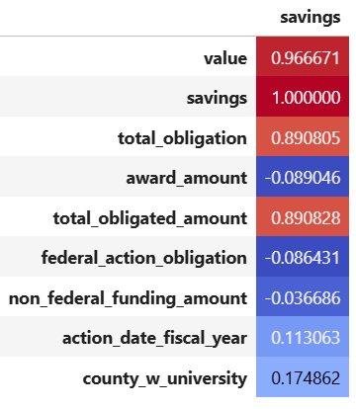
Correlation Mapping
Notes:
Another variable we constructed is the “savings” per capita for each county within North Carolina
This is where the third dataset comes in, since we’re dividing the decline by the population
From this graph, you can see the top five counties with the greatest decline per capita in funding from DOGE
Notice how most of these counties contain a large research university?

